Slide 1


VISIONEXTRACT: ISOLATION FROM IMAGES USING IMAGE SEGMENTATION

Slide 2

PRESENTATION
AGENDA
Overview of Milestone 2
Week 3: Initial Model Training
Dataset Preparation
U-Net Model Architecture
Training Configuration
Week 4: Predictions & Fine-Tuning
Evaluation Metrics & Results
Challenges Faced & Solutions
Key Learnings & Conclusion

Slide 3




MILESTONE 2
OVERVIEW
Designed and trained a semantic segmentation model for subject isolation
Applied fine-tuning techniques to improve boundary accuracy
1
Validated model performance on unseen test data to ensure generalization
Performed quantitative and qualitative evaluation of segmentation performance
2

Slide 4
WEEK 3
INITIAL MODEL TRAINING
Objective:
To train a deep learning model capable of accurately separating foreground subjects from the background at the pixel level.
Key Aspects:
Model Type: U-Net convolutional neural network
Task: Binary image segmentation
Output: Pixel-wise classification (foreground vs background)

Slide 5


WEEK 3
DATA PREPARATION
Dataset Used: COCO 2017 – val2017
Total Images: 5000
Data Split:
Training: 70% (3500 images)
Validation: 15% (750 images)
Testing: 15% (750 images)
Random shuffling ensured unbiased data distribution
Ground-truth masks used for supervised learning

Slide 6
WEEK 3
U-NET MODEL ARCHITECTURE
Encoder–Decoder based architecture
Encoder: Extracts high-level contextual features through convolution and pooling
Decoder: Restores spatial resolution using up-sampling layers
Skip Connections: Transfer fine-grained features from encoder to decoder
Output: Binary segmentation mask highlighting subject regions

Slide 7

WEEK 3
MODEL TRAINING DETAILS
Loss Function: Binary Cross-Entropy (BCE)
Optimizer: Adam Optimizer
Learning Rate: 0.0001
Batch Size: 8
Training performed over multiple epochs
Validation loss monitored to track learning progress and avoid overfitting

Slide 8
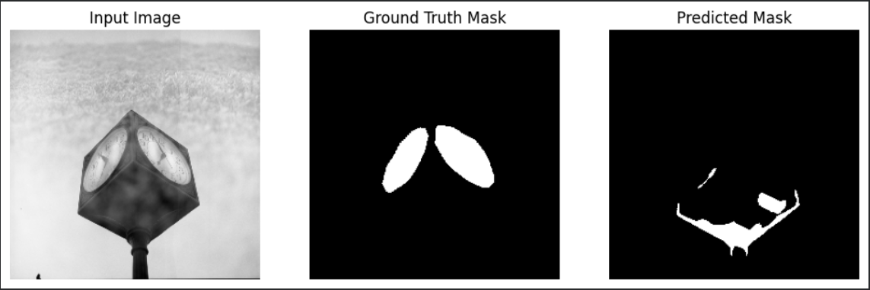
WEEK 3
EARLY PREDICTION VISUALIZATION
Generated predictions during early training epochs
Compared predicted masks with ground-truth masks
Verified correct learning of subject regions
Ensured proper data flow and correctness of training pipeline

Slide 9
WEEK 4
PREDICTIONS AND FINE-TUNING
Objective:
To enhance segmentation accuracy and mask quality through evaluation and fine-tuning.
Tasks Performed:
Generated predictions on validation data
Evaluated performance using standard segmentation metrics
Applied fine-tuning strategies to improve results

Slide 10
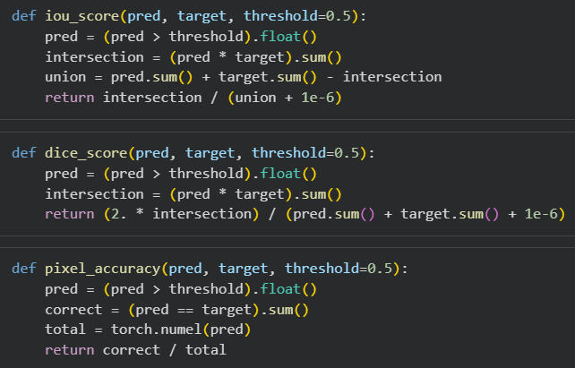
WEEK 4
EVALUATION METRICS USED
Intersection over Union (IoU): Measures overlap between predicted and ground-truth masks
Dice Coefficient: Evaluates similarity between two segmentation outputs
Pixel-wise Accuracy: Computes proportion of correctly classified pixels
These metrics collectively assess segmentation quality and reliability.

Slide 11


WEEK 4
VALIDATION RESULTS ANALYSIS
Predicted masks visually compared with ground-truth masks
Observed accurate subject extraction with minor boundary imperfections
Detected noise in complex background regions
Insights from validation guided fine-tuning decisions

Slide 12
WEEK 4
FINE-TUNING STRATEGY
Introduced combined loss function (BCE + Dice Loss)
Reduced learning rate for more stable weight updates
Increased training epochs to refine feature learning
Focused on improving boundary precision and mask smoothness

Slide 13
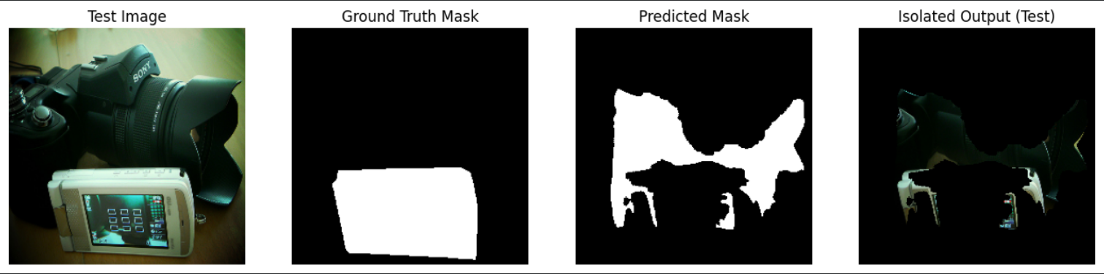
WEEK 4
TEST SET EVALUATION
Evaluated model on unseen test dataset (15%)
Computed IoU, Dice, and Pixel Accuracy
Confirmed strong generalization capability
Verified absence of overfitting

Slide 14
MILESTONE 2
KEY OUTCOMES
Successfully trained a U-Net based segmentation model
Achieved reliable subject-background separation
Improved segmentation accuracy through fine-tuning
Validated performance on unseen data

Slide 15
MILESTONE 2
CHALLENGES FACED AND SOLUTIONS
Challenge 1: Boundary Inaccuracy in Segmentation
Solution: Used a combined loss function (Binary Cross-Entropy + Dice Loss) to improve edge precision and mask overlap.
Challenge 2: Noise in Background Regions
Solution: Applied fine-tuning with a reduced learning rate to stabilize training and produce smoother masks.
Challenge 3: Overfitting on Training Data
Solution: Monitored validation loss and evaluated performance on an unseen test dataset to ensure generalization.
Challenge 4: Slow Learning in Initial Epochs
Solution: Used the Adam optimizer with an optimized learning rate to accelerate convergence.

Slide 16
MILESTONE 2
CONCLUSION
Milestone 2 objectives were successfully achieved
The trained model is suitable for real-world inference
Provides a strong foundation for deployment and future improvements
Next Steps: Integration into inference pipeline and UI development

Slide 17




THANK YOU

